Slide 1

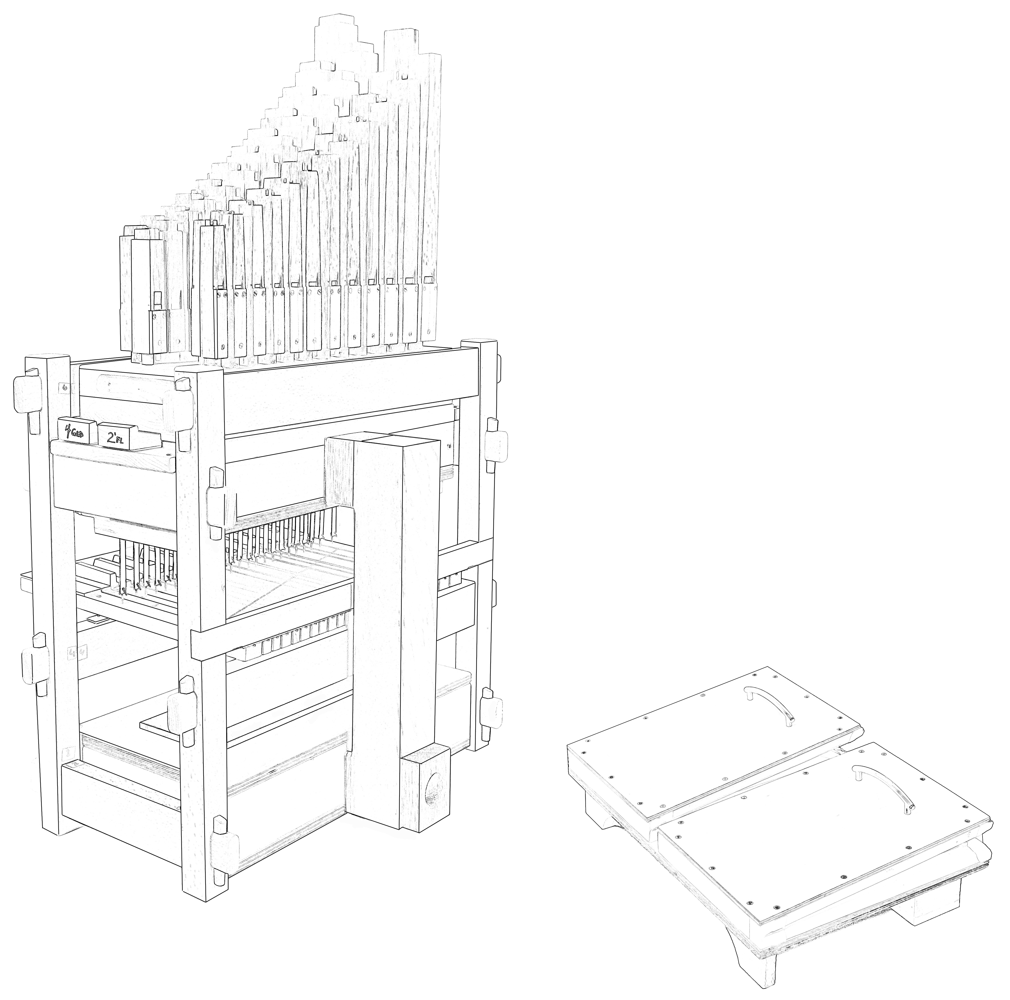
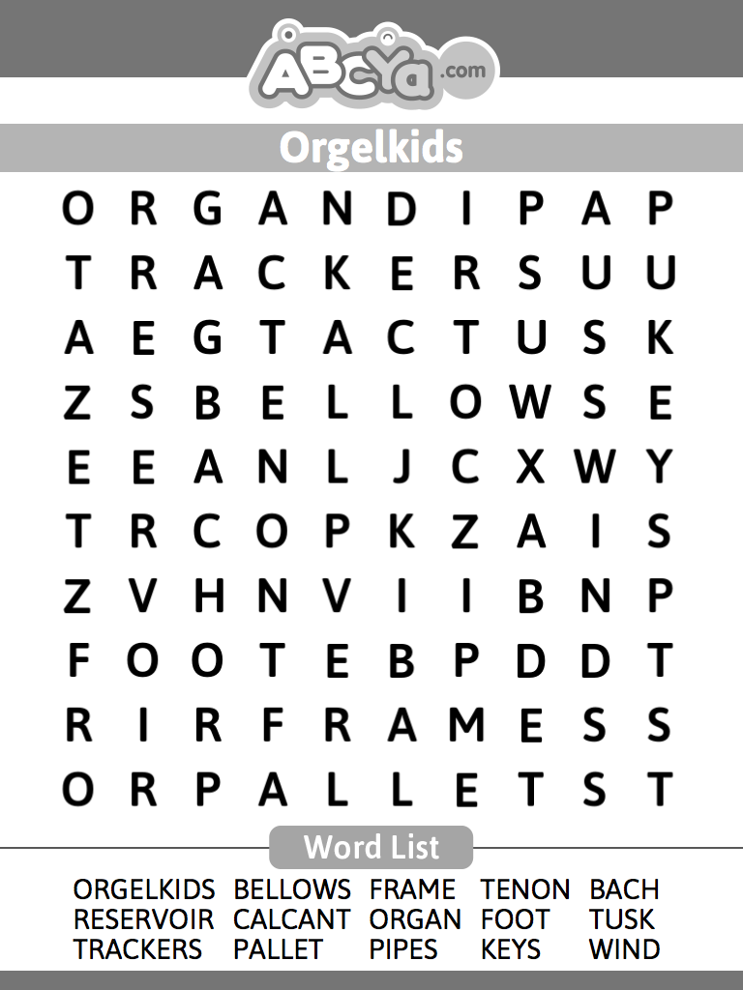
Name:___________________
Path of Wind in a Pipe Organ
Trace the path wind would take through this pipe organ by writing the order (#1-7) in the circled locations.
Word Search
Now that you have built a pipe organ & know how they work, go check out a REALLY BIG organ in concert!

Slide 2
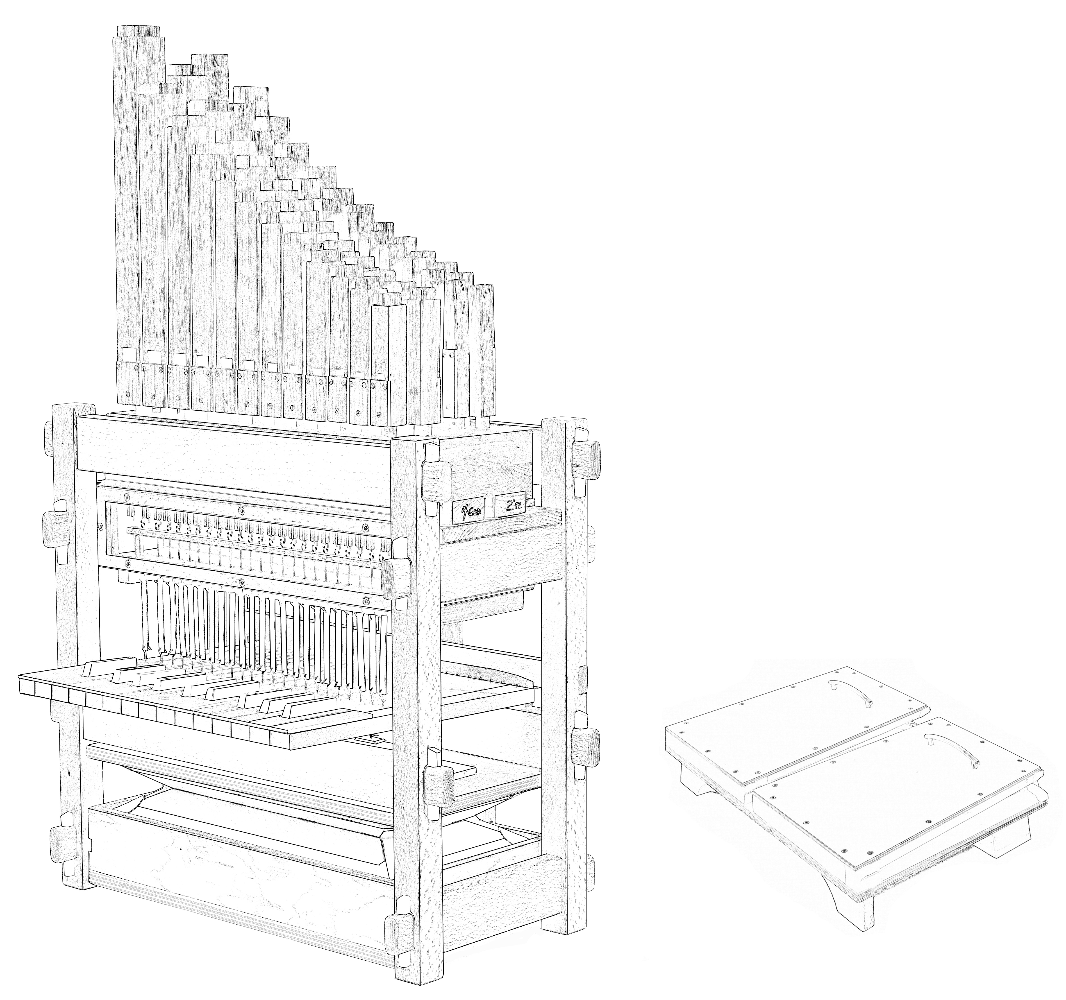
Name:______________________
Parts of a Pipe Organ
Word Bank
pipes windchest keys
feeder bellows sliders
toe board trackers
reservoir bellows pallet box
tusk tenon joints mouths
or
www.OrgelkidsUSA.org

